Slide 1


advanced java 2
Lecture 1: Multithreading
Talgat Manglayev
Abzal Kyzyrkanov
Eldiyar Zhantileuov

Slide 2
Multithreading
Example in application
Processor Specifications
Basic Example (extends Thread)
Java Thread State, Schedule and Priority
Another Basic Example (implements Runnable)
Thread Executor
Thread Synchronization

Slide 3
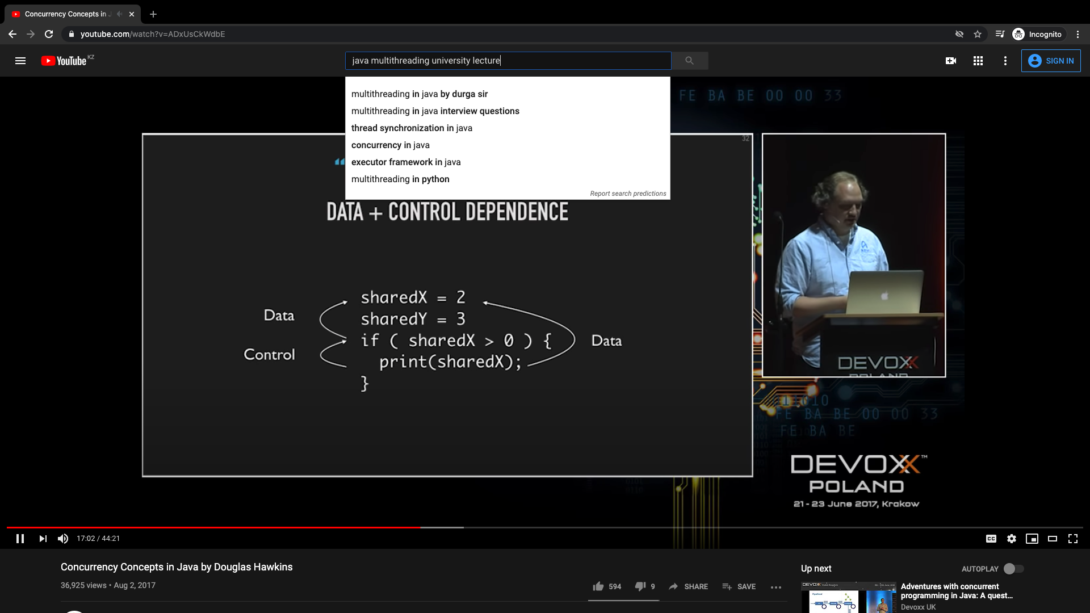
EXAMPLE in YouTube application
simultaneous tasks
playing video progress bar
downloading video progress bar
timer
search suggestions
play video
Can you find more?
4
1
2
3

Slide 4

Processor Specifications

Slide 5


Processor Specifications
# of Cores
Cores is a hardware term that describes the number of independent central processing units in a single computing component (die or chip).
# of Threads
A Thread, or thread of execution, is a software term for the basic ordered sequence of instructions that can be passed through or processed by a single CPU core.
https://ark.intel.com/content/www/us/en/ark/products/64900/intel-core-i7-3615qm-processor-6m-cache-up-to-3-30-ghz.html?wapkw=i7-3615QM

Slide 6
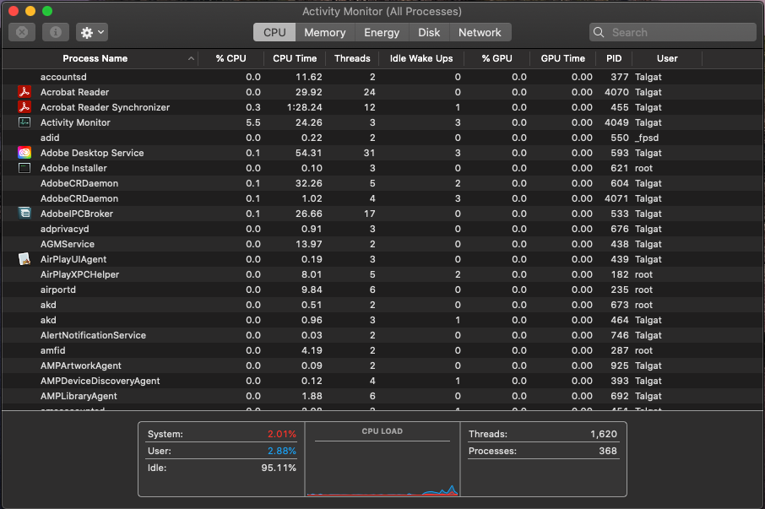





Processor Specifications
Why does the number of threads in activity monitor window (circled in red) exceed the number of threads in CPU specifications (previous slide)?

Slide 7
Basic Java Example (extends Thread)
kz.edu.astanait.ajp2.Example
package kz.edu.astanait.ajp2;
public class Example_1 extends Thread{
public void run()
{
for(int a=0;a<5;a++)
{
System.out.println("class Example_1: "+a);
}
}
}
kz.edu.astanait.ajp2.Main
package kz.edu.astanait.ajp2;
public class Main
{
public static void main(String[] args)
{
Example_1 example_1 = new Example_1();
example_1.start();
}
}
output:
class Example_1: 0
class Example_1: 1
class Example_1: 2
class Example_1: 3
class Example_1: 4

Slide 8




package kz.edu.astanait.ajp2;
public class Example_2
{
public void example_2()
{
Class_1 thread_1 = new Class_1();
Class_2 thread_2 = new Class_2();
thread_1.start();
thread_2.start();
}
public class Class_1 extends Thread
{
public void run()
{
for(int a=0;a<5;a++)
{
System.out.println("class Class_1 :"+a);
}
}
}
public class Class_2 extends Thread
{
public void run()
{
for(int a=0;a<5;a++)
{
System.out.println("class Class_2 :"+a);
}
}
}
} // close class Example_2
package kz.edu.astanait.ajp2;
public class Main
{
public static void main(String[] args)
{
Example_2 example_2 = new Example_2();
example_2.example_2();
}
}
output 1:
class Class_1 :0
class Class_2 :0
class Class_1 :1
class Class_2 :1
class Class_1 :2
class Class_2 :2
class Class_1 :3
class Class_2 :3
class Class_1 :4
class Class_2 :4
output 2:
class Class_2 :0
class Class_1 :0
class Class_1 :1
class Class_2 :1
class Class_1 :2
class Class_2 :2
class Class_1 :3
class Class_2 :3
class Class_1 :4
class Class_2 :4
The program ran twice with different order within each run()

Slide 9
Basic Java Example (extends Thread)
What if we call methods from both classes?
package kz.edu.astanait.ajp2;
import kz.edu.astanait.ajp2.Example_2.Class_1;
public class Main
{
public static void main(String[] args)
{
Example_1 example_1 = new Example_1();
Example_2 example_2 = new Example_2();
example_1.start();
example_2.example_2();
}
}
output:
class Example_1: 0
class Example_1: 1
class Class_1 :0
class Class_2 :0
class Class_1 :1
class Example_1: 2
class Class_1 :2
class Class_2 :1
class Class_1 :3
class Example_1: 3
class Class_1 :4
class Class_2 :2
class Example_1: 4
class Class_2 :3
class Class_2 :4
Unordered call for methods run() of each class can be recognized from the output

Slide 10
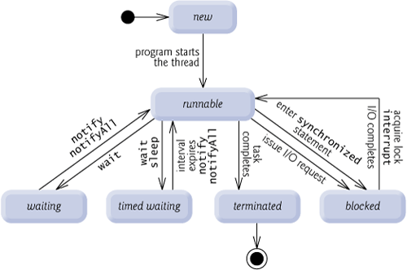
Thread State
Paul Deitel, Harvey Deitel. Java How to program, Eight edition, chapter 26: Multithreading

Slide 11
Thread Schedule and Priority
At the operating system level, Java’s runnable state typically encompasses two separate states: ready and running. The operating system hides these states from the JVM, which sees only the runnable state. When a thread first transitions to the runnable state from the new state, the thread is in the ready state. A ready thread enters the running state (i.e., begins executing) when the operating system assigns the thread to a processor—also known as dispatching the thread. In most operating systems, each thread is given a small amount of processor time—called a quantum or timeslice—with which to perform its task. When its quantum expires, the thread returns to the ready state and the operating system assigns another thread to the processor. Transitions between the ready and running states are handled solely by the operating system. The JVM does not “see” the transitions—it simply views the thread as being runnable and leaves it up to the operating system to transition the thread between ready and running. The process that an operating system uses to determine which thread to dispatch is called thread scheduling and is dependent on thread priorities.
Paul Deitel, Harvey Deitel. Java How to program, Eight edition, chapter 26: Multithreading

Slide 12
Thread Schedule and Priority
Java thread priority: MIN_PRIORITY (1), NORM_PRIORITY (5), MAX_PRIORITY (10).
With timeslicing, even if a thread has not finished executing when its quantum expires, the processor is taken away from the thread and given to the next thread of equal priority, if one is available.
If there is more than one highest-priority thread, OS thread scheduler ensures that all such threads execute for a quantum each in round-robin fashion.
Paul Deitel, Harvey Deitel. Java How to program, Eight edition, chapter 26: Multithreading

Slide 13
Basic Java Example (implements Runnable)
package kz.edu.astanait.ajp2;
public class Example_1 implements Runnable
{
int id;
public Example_1(int name)
{
this.id=name;
}
@Override
public void run()
{
System.out.println("Thread id: "+id);
}
}
package kz.edu.astanait.ajp2;
public class Main
{
public static void main(String[] args)
{
int size = 5;
Thread[] threads = new Thread[size];
for (int a=0; a<size; a++)
{
threads[a] = new Thread( new Example_1(a));
threads[a].start();
}
}
}
output:
Thread id: 2
Thread id: 3
Thread id: 1
Thread id: 4
Thread id: 0

Slide 14
package kz.edu.astanait.ajp2;
import java.util.Random;
public class Example_2 implements Runnable
{
int id;
int time;
Random generator = new Random();
public Example_2(int name)
{
this.id=name;
time=generator.nextInt(5000);
}
@Override
public void run()
{
try
{
Thread.sleep(time);
System.out.println("id: "+id+"; sleep time: "+time);
}
catch(Exception exception)
{
exception.printStackTrace();
}
}
}
package kz.edu.astanait.ajp2;
public class Main
{
public static void main(String[] args)
{
int size = 5;
Thread[] threads = new Thread[size];
for (int a=0; a<size; a++)
{
threads[a] = new Thread( new Example_2(a));
threads[a].start();
}
}
}
output:
id: 1; sleep time: 186
id: 4; sleep time: 1010
id: 3; sleep time: 1242
id: 0; sleep time: 2004
id: 2; sleep time: 3750

Slide 15
Executor
prepares a thread pool to execute Runnables.
allows to reuse threads, preventing processing creating a new one.
declares execute(Runnable) method
assigns accepted Runnable to a thread in pool
if (thread is not found)
creates a new thread or waits available thread
Executor
ExecutorService
ScheduledExecutorService

Slide 16
package kz.edu.astanait.ajp2;
import java.util.Random;
public class Example_1 implements Runnable
{
int id;
int time;
Random generator = new Random();
public Example_1(int name)
{
this.id=name;
time=generator.nextInt(5000);
}
@Override
public void run()
{
try
{
Thread.sleep(time);
System.out.print("id:"+id+"; ");
System.out.println("sleep time: "+time);
}
catch(Exception exception)
{
exception.printStackTrace();
}
}
}
package kz.edu.astanait.ajp2;
import java.util.concurrent.ExecutorService;
import java.util.concurrent.Executors;
public class Main
{
public static void main(String[] args)
{
int size = 5;
ExecutorService threadExecutor = Executors.newCachedThreadPool();
for (int a=0; a<size; a++)
{
threadExecutor.execute(new Example_1(a));
}
threadExecutor.shutdown();
}
}
output:
id:4; sleep time: 795
id:3; sleep time: 1773
id:2; sleep time: 2052
id:0; sleep time: 3297
id:1; sleep time: 4390

Slide 17
Thread Synchronization
It is possible to run parallel threads and execute several tasks.
What if several threads try to change value of the same object?

Slide 18
Thread Synchronization
problem scenario:
Thread-1 gets value of an object in order to change, then thread-2 changes the value before thread-1 saves the object. In this case thread-1 works with old value of the object.
EXAMPLE 4: SYNCHRONIZATION
Thread-1
Thread-2
object

Slide 19
Thread Synchronization
problem solution:
Ensure only one thread at a time can access an object.
One thread
1) gets value of the object
2)changes the value
3) saves new updated value to the object.
These three steps form atomic operation and cannot be divided.
synchronized (object)
{
statements
}

Slide 20
Thread Synchronization
In order to manage multiple threads trying access one object:
Only one thread is given access to the object
and
the rest threads are waiting.
thread synchronization
synchronized (object)
{
statements
}
mutual exclusion

Slide 21
Thread Synchronization
EXAMPLE 5: SYNCHRONIZATION

Slide 22
resources
Paul Deitel, Harvey Deitel. Java How to program, Eight edition, chapter 26: Multithreading
https://www.w3schools.com/java/java_threads.asp
https://docs.oracle.com/javase/tutorial/essential/concurrency/index.html
https://www.tutorialspoint.com/java/java_multithreading.htm
https://www.geeksforgeeks.org/multithreading-in-java/
https://stackoverflow.com/questions/34689709/java-threads-and-number-of-cores
https://apple.stackexchange.com/questions/304995/how-can-i-have-1805-threads-when-i-only-have-4-virtual-cpus

Slide 23


Questions?
astanait.edu.kz

